Slide 1

Introduction of Computer Network
Dr. Kamlesh Chandravanshi
VIT, Bhopal
School of Computer Science & Enginnering

Slide 2
UNIT-1 Content
Network Topology
Computer Network Types

Slide 3
Network Topologies
A Network Topology is the arrangement with which computer systems or network devices are connected to each other. Topologies may define both physical and logical aspect of the network. Both logical and physical topologies could be same or different in a same network.
Point-to-Point
Bus Topology
Star Topology
Ring Topology
Mesh Topology
Tree Topology
Daisy Chain
Hybrid Topology

Slide 4

Point-to-Point
Point-to-point networks contains exactly two hosts such as computer, switches or routers, servers connected back to back using a single piece of cable.

Slide 5
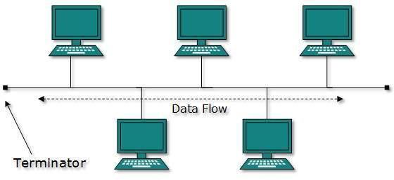
Bus Topology
all devices share single communication line or cable. Bus topology may have problem while multiple hosts sending data at the same time.

Slide 6
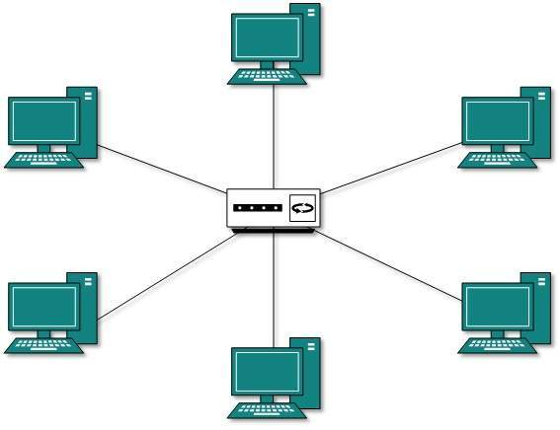
Star Topology
All hosts in Star topology are connected to a central device, known as hub device, using a point-to-point connection. That is, there exists a point to point connection between hosts and hub. The hub device can be any of the following:
Layer-1 device such as hub or repeater
Layer-2 device such as switch or bridge
Layer-3 device such as router or gateway

Slide 7
Switch 8 port → 200rs
16 p-> 400rs
128→ 1000
256-> 1800
Use star topology and connect 130 pc
256 -> 1800
130 all of computer
256-130
Yes 128 + 8 port ➔ 136 (2port for two switch)=134
134 -130 => 4 unused

Slide 8
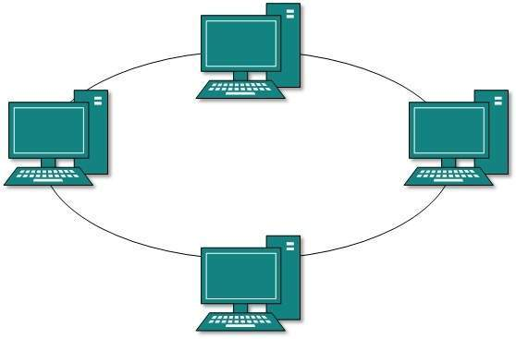
Ring Topology
In ring topology, each host machine connects to exactly two other machines, creating a circular network structure. When one host tries to communicate or send message to a host which is not adjacent to it, the data travels through all intermediate hosts.

Slide 9
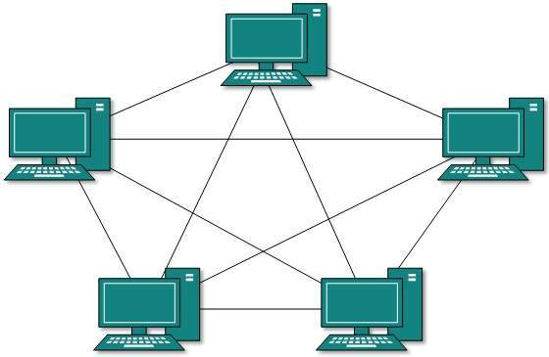
Mesh Topology
A host is connected to one or multiple hosts. This topology has hosts in point-to-point connection with every other host or may also have hosts which are in point-to-point connection to few hosts only.
Mesh technology comes into two types:
Full Mesh
Partially Mesh

Slide 10
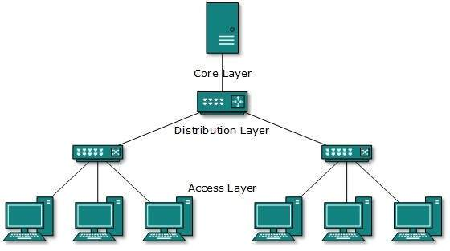
Tree Topology
Also known as Hierarchical Topology, this is the most common form of network topology in use presently. This topology imitates as extended Star topology and inherits properties of bus topology.

Slide 11

Daisy Chain
This topology connects all the hosts in a linear fashion. Similar to Ring topology, all hosts are connected to two hosts only, except the end hosts. Means, if the end hosts in daisy chain are connected then it represents Ring topology.
Each link in daisy chain topology represents single point of failure. Every link failure splits the network into two segments. Every intermediate host works as relay for its immediate hosts.

Slide 12
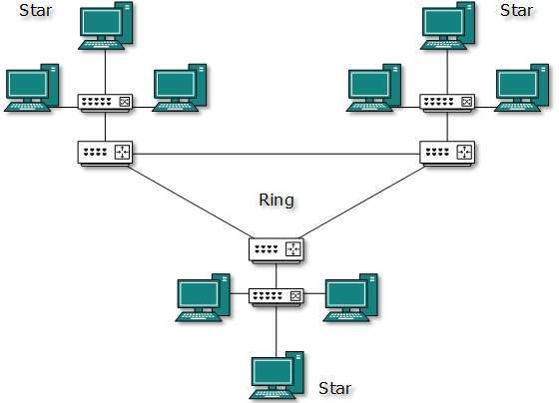
Hybrid Topology
A network structure whose design contains more than one topology is said to be hybrid topology. Hybrid topology inherits merits and demerits of all the incorporating topologies.

Slide 13
Computer Network Types
Personal Area Network
Local Area Network
Metropolitan Area Network
Wide Area Network
Internetwork

Slide 14
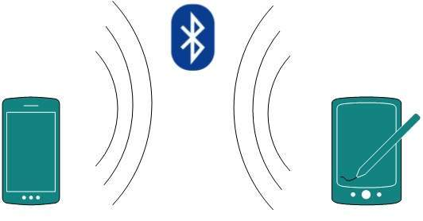
Generally, networks are distinguished based on their geographical span. A network can be as small as distance between your mobile phone and its Bluetooth headphone and as large as the internet itself, covering the whole geographical world.
Personal Area Network
A Personal Area Network (PAN) is smallest network which is very personal to a user. This may include Bluetooth enabled devices or infra-red enabled devices. PAN has connectivity range up to 10 meters. PAN may include wireless computer keyboard and mouse, Bluetooth enabled headphones, wireless printers and TV remotes.

Slide 15
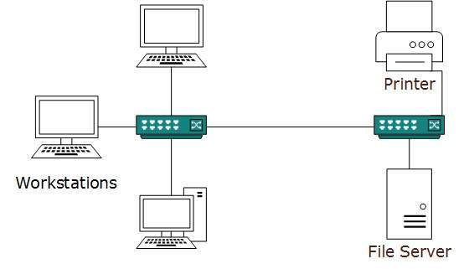
Local Area Network
A computer network spanned inside a building and operated under single administrative system is generally termed as Local Area Network (LAN). Usually, LAN covers an organization’ offices, schools, colleges or universities. Number of systems connected in LAN may vary from as least as two to as much as 16 million.
LAN provides a useful way of sharing the resources between end users. The resources such as printers, file servers, scanners, and internet are easily sharable among computers.

Slide 16
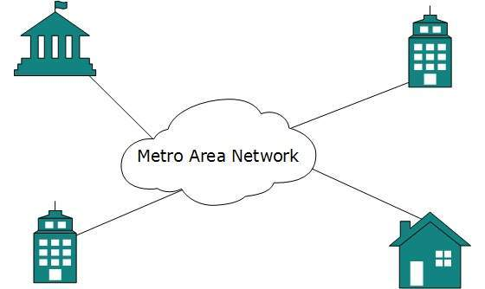
Metropolitan Area Network
The Metropolitan Area Network (MAN) generally expands throughout a city such as cable TV network. It can be in the form of Ethernet, Token-ring, ATM, or Fiber Distributed Data Interface (FDDI).

Slide 17
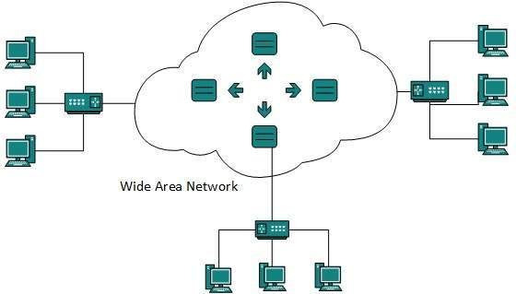
Wide Area Network
Wide Area Network (WAN) covers a wide area which may span across provinces and even a whole country. Generally, telecommunication networks are Wide Area Network. These networks provide connectivity to MANs and LANs. Since they are equipped with very high speed backbone, WANs use very expensive network equipment.

Slide 18
Internetwork
A network of networks is called an internetwork, or simply the internet. It is the largest network in existence on this planet. The internet hugely connects all WANs and it can have connection to LANs and Home networks. Internet uses TCP/IP protocol suite and uses IP as its addressing protocol.
Internet is serving many proposes and is involved in many aspects of life. Some of them are:
Web sites
E-mail
Instant Messaging
Blogging
Social Media
Marketing
Networking
Resource Sharing
Audio and Video Streaming

